Slide 1
Lecture 1-3
Introduction to Databases

Slide 2
Outline
Introduction
Traditional File Based system
File-Based Approach
Limitation of File Based system
Database Approach
Applications of Database System
View of Data
Data Abstraction
Instances and Schemas
Data Models
Database Languages
DML
DDL
Database Design
Design Process
The Entity-Relationship Model
Normalization
Data Storage and Querying
Storage Manager
The Query Processor
Transaction Management
Database Architecture
Database Users and Administrators

Slide 3
Introduction
What is Data?
Fact and Figures or distinct pieces of information
What is a database?
Collection of related data.
What is a database Management System?
Database systems give a set of tools for storing, searching and managing this information
What is a database Application?
database application is simply a program that interacts with the database at some point in its execution. It is an intermediary between user and DBMS.

Slide 4
Traditional File Based System
A collection of application programs that perform services for the end-users, such as the production of reports. Each program defines and manages its own data.
Conventional file systems are inadequate as database systems, because they fail to support efficient search, efficient modifications to small pieces of data, complex queries, or atomic and independent execution of transactions.

Slide 5
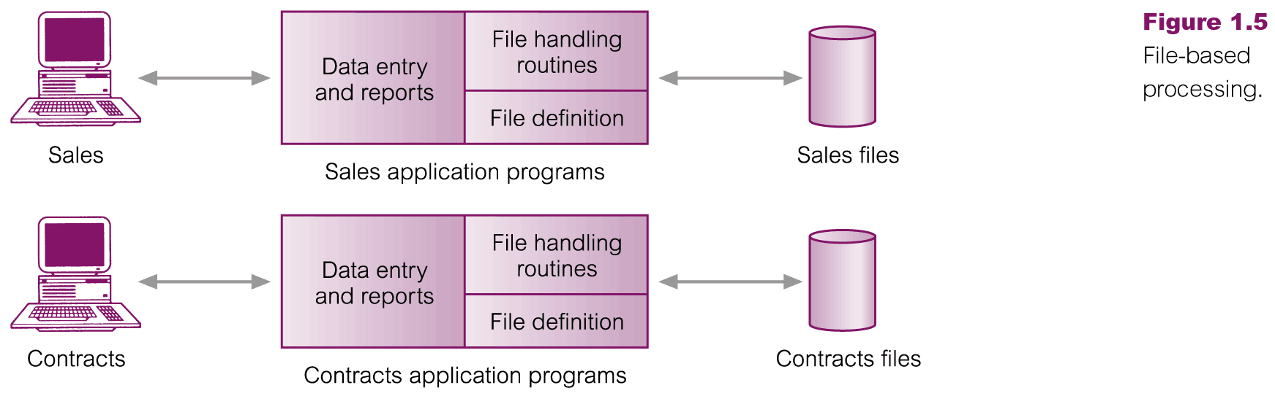
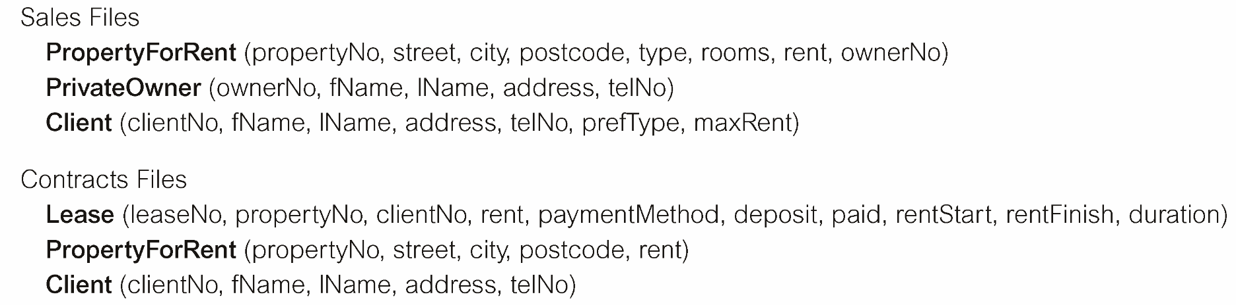
File-Based Processing
© Pearson Education Limited 1995, 2005

Slide 6
Activity
Make a group of two people
Search on web or from your text book the limitation of the file based system.
Give presentation on it using board.

Slide 7
Limitation of File Based system
In the early days, database applications were built on top of file systems
Drawbacks of using file systems to store data:
Data redundancy and inconsistency
Multiple file formats, duplication of information in different files
Difficulty in accessing data
Need to write a new program to carry out each new task
Data isolation — multiple files and formats:
Incompatible file formats
Programs are written in different languages, and so cannot easily access each other’s files.
Integrity problems
Integrity constraints (e.g. account balance > 0) become part of program code
Hard to add new constraints or change existing ones
Fixed Queries/Proliferation of application programs
Any new requirement needs a new program.

Slide 8
Limitation of File Based system(Cont.)
Atomicity of updates
Failures may leave database in an inconsistent state with partial updates carried out
E.g. transfer of funds from one account to another should either complete or not happen at all
Concurrent access by multiple users
Concurrent accessed needed for performance
Uncontrolled concurrent accesses can lead to inconsistencies
E.g. two people reading a balance and updating it at the same time
Security problems
Database systems offer solutions to all the above problems

Slide 9
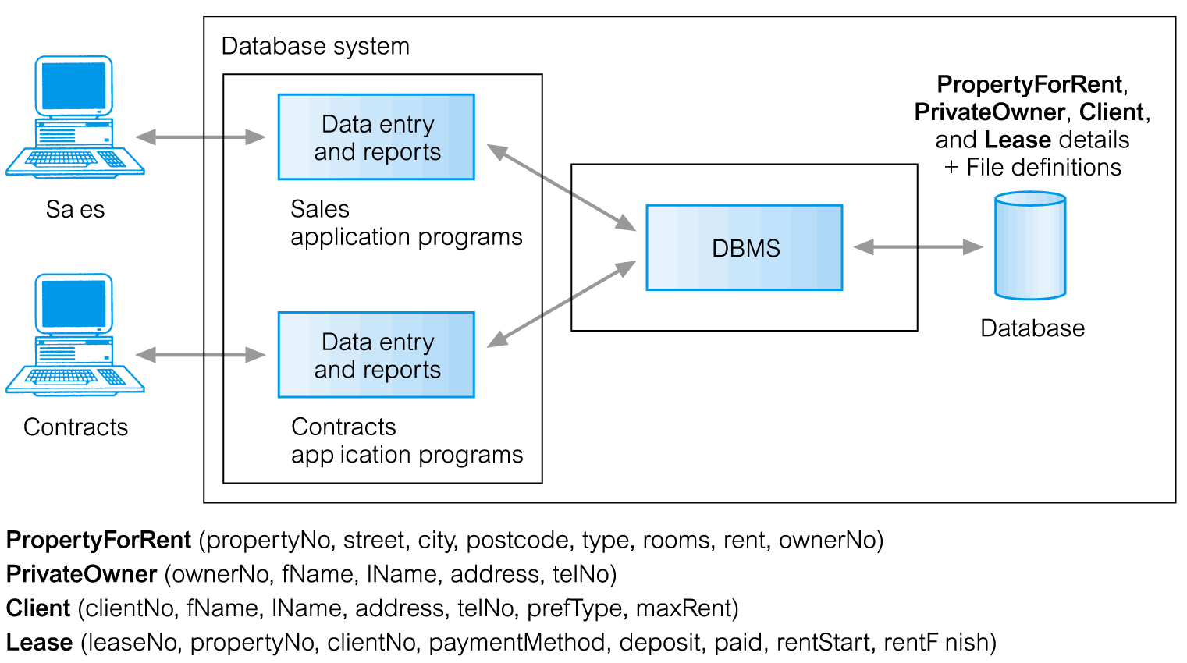
Database Management System (DBMS)
© Pearson Education Limited 1995, 2005

Slide 10
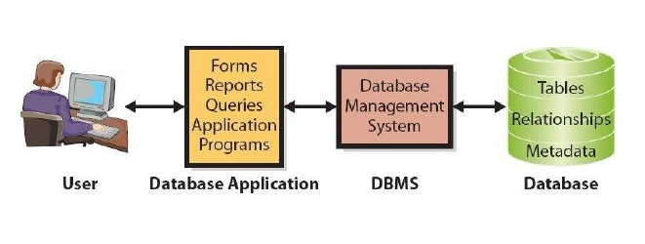
Database Approach

Slide 11
Applications of Database-System
Enterprise Information: Sales, Accounting, Human Resource
Airline reservation systems: For reservation, scheduling
Banking systems: Credit and transaction, Finance
Telecommunication: records of calls, monthly bills, communication networks

Slide 12
Levels of Abstraction
Physical level describes how a record (e.g., customer) is stored.
Logical level: describes data stored in database, and the relationships among the data.
type customer = record name : string; street : string; city : integer; end;
View level: application programs hide details of data types. Views can also hide information (e.g., salary) for security purposes.

Slide 13
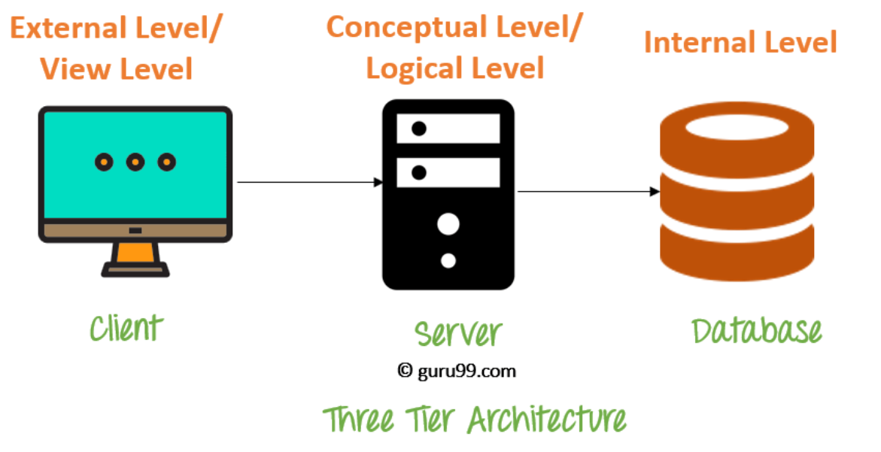

Slide 14
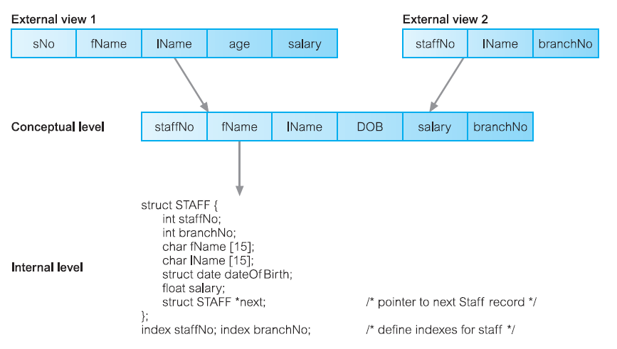

Slide 15
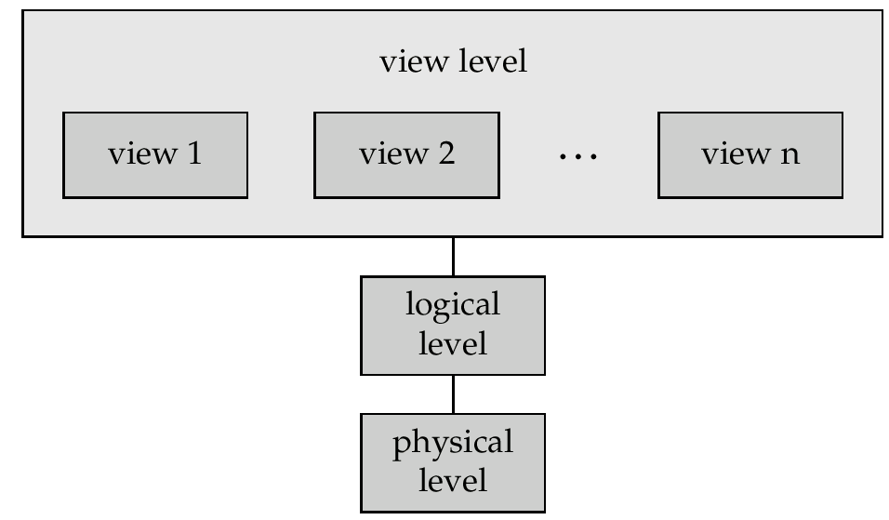
View of Data
Allows each user to have his or her own view of the database.
A view is essentially some subset of the database.
An architecture for a database system

Slide 16
Views - Benefits
Reduce complexity
Provide a level of security
Provide a mechanism to customize the appearance of the database
Present a consistent, unchanging picture of the structure of the database, even if the underlying database is changed

Slide 17
Instances and Schemas
Similar to types and variables in programming languages
Schema – the structure view (design) of the database
e.g., the database consists of information about a set of customers and accounts and the relationship between them)
Analogous to type information of a variable in a program
Physical schema: database design at the physical level
Logical schema: database design at the logical level
Instance – the actual content of the database at a particular point in time
Analogous to the value of a variable
Physical Data Independence – the ability to modify the physical schema without changing the logical schema
Applications depend on the logical schema
In general, the interfaces between the various levels and components should be well defined so that changes in some parts do not seriously influence others.

Slide 18
Data Models
A collection of tools for describing
Data, Data relationships, Data semantics, Data constraints
A data model provides a way to describe the design of a database at the physical, logical, and view levels. The data models can be classified into four different categories:
Relational model
Entity-Relationship data model (mainly for database design)
Object-based data models (Object-oriented and Object-relational)
Semistructured data model (XML)
Other older models:
Network model
Hierarchical model
Notes:
18

Slide 19
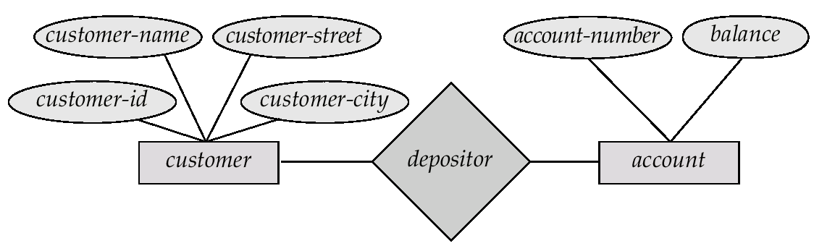
Entity-Relationship Model
Example of schema in the entity-relationship model

Slide 20
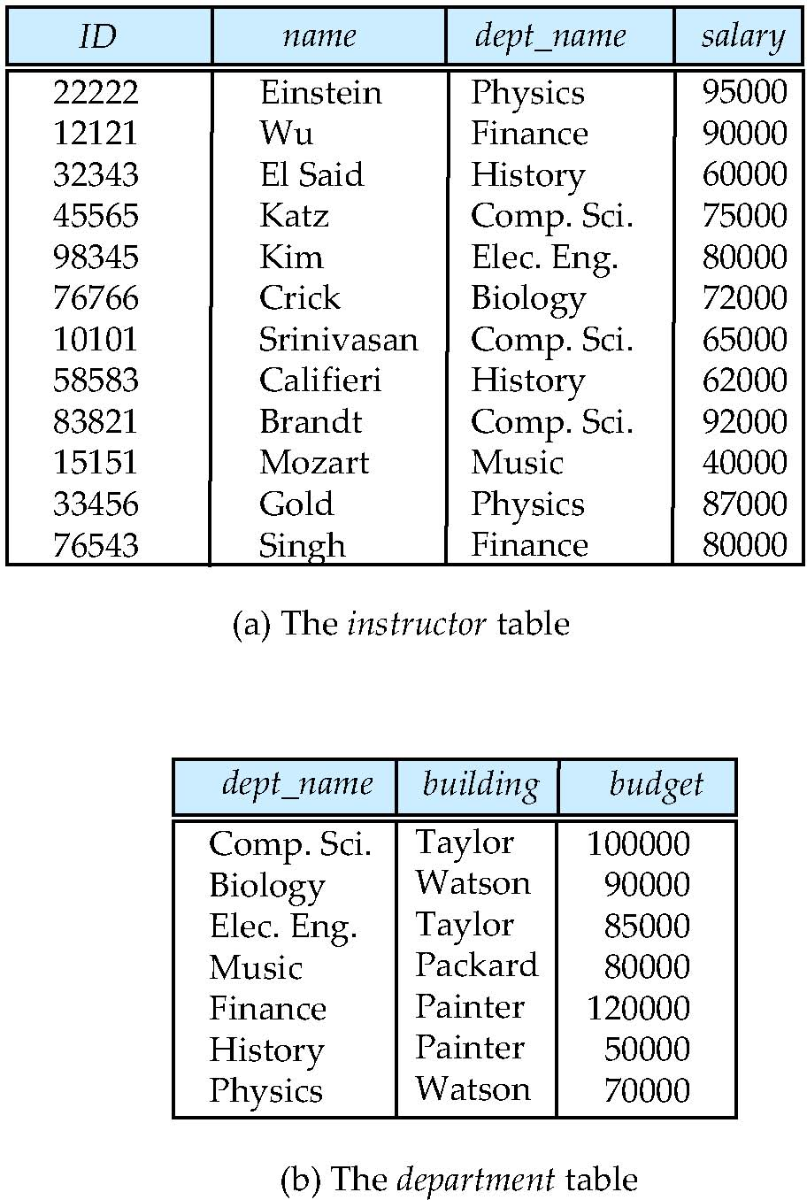
Relational Model
All the data is stored in various tables.
Example of tabular data in the relational model
Columns
Rows
Notes:
20

Slide 21
A Sample Relational Database
Notes:
21

Slide 22
Database Languages
Database system provides DDL to specify the database schema and DML to express database queries and updates.

Slide 23
Data Definition Language (DDL)
Specification notation for defining the database schema
E.g. create table account ( account-number char(10), balance integer)
DDL compiler generates a set of tables stored in a data dictionary
Data dictionary contains metadata (i.e., data about data)
Data storage and definition language
These statements define the implementation details of the database schemas, which are usually hidden from the users.
Usually an extension of the data definition language

Slide 24
Data Manipulation Language (DML)
Language for accessing and manipulating the data organized by the appropriate data model
DML also known as query language
Two classes of languages
Procedural – user specifies what data is required and how to get those data
Nonprocedural – user specifies what data is required without specifying how to get those data
SQL is the most widely used query language

Slide 25
SQL
SQL: widely used non-procedural language
E.g. find the name of the customer with customer-id 192-83-7465 select customer.customer-name from customer where customer.customer-id = ‘192-83-7465’
E.g. find the balances of all accounts held by the customer with customer-id 192-83-7465 select account.balance from depositor, account where depositor.customer-id = ‘192-83-7465’ and depositor.account-number = account.account-number
Application programs generally access databases through one of
Language extensions to allow embedded SQL
Application program interface (e.g. ODBC/JDBC) which allow SQL queries to be sent to a database

Slide 26
Database Design
The process of designing the general structure of the database:
Specification: to characterize fully the data needs of the prospective database users.
Conceptual Design: The focus at this point is on describing the data and their relationships
Business decision – What attributes should we record in the database?
Computer Science decision – What relation schemas should we have and how should the attributes be distributed among the various relation schemas?
There are principally two ways to tackle the problem.
entity-relationship model
Normalization: that takes as input the set of all attributes and generates a set of tables
Notes:
26

Slide 27
Continue
The process of moving from an abstract data model to the implementation of the database proceeds in two final design phases
Logical Design: designer maps the high-level conceptual schema onto the implementation data model of the database system that will be used
Physical Design: the physical features of the database are specified. These features include the form of file organization and the internal storage structures

Slide 28
Design Approaches
Need to come up with a methodology to ensure that each of the relations in the database is “good”
Two ways of doing so:
Entity Relationship Model (Chapter 7)
Models an enterprise as a collection of entities and relationships
Represented diagrammatically by an entity-relationship diagram:
Normalization Theory (Chapter 8)
Formalize what designs are bad, and test for them
Notes:
28

Slide 29
Database Engine
Storage manager
Query processing
Notes:
29

Slide 30
Storage Management
Storage manager is a program module that provides the interface between the low-level data stored in the database and the application programs and queries submitted to the system.
The storage manager is responsible to the following tasks:
Interaction with the OS file manager
Efficient storing, retrieving and updating of data
Issues:
Storage access
File organization
Indexing and hashing
Notes:
30

Slide 31
Query Processing
The query processor components include:
DDL interpreter, which interprets DDL statements and records the definitions
in the data dictionary.
DML compiler, which translates DML statements in a query language into an
evaluation plan consisting of low-level instructions that the query evaluation
engine understands.
The DML compiler also performs query optimization; that is, it picks the lowest cost evaluation plan from among the alternatives.
Query evaluation engine, which executes low-level instructions generated by the DML compiler.
Notes:
31

Slide 32
Transaction Management
What if the system fails?
What if more than one user is concurrently updating the same data?
A transaction is a collection of operations that performs a single logical function in a database application
Transaction-management component ensures that the database remains in a consistent (correct) state despite system failures (e.g., power failures and operating system crashes) and transaction failures.
Concurrency-control manager controls the interaction among the concurrent transactions, to ensure the consistency of the database.
Notes:
32

Slide 33
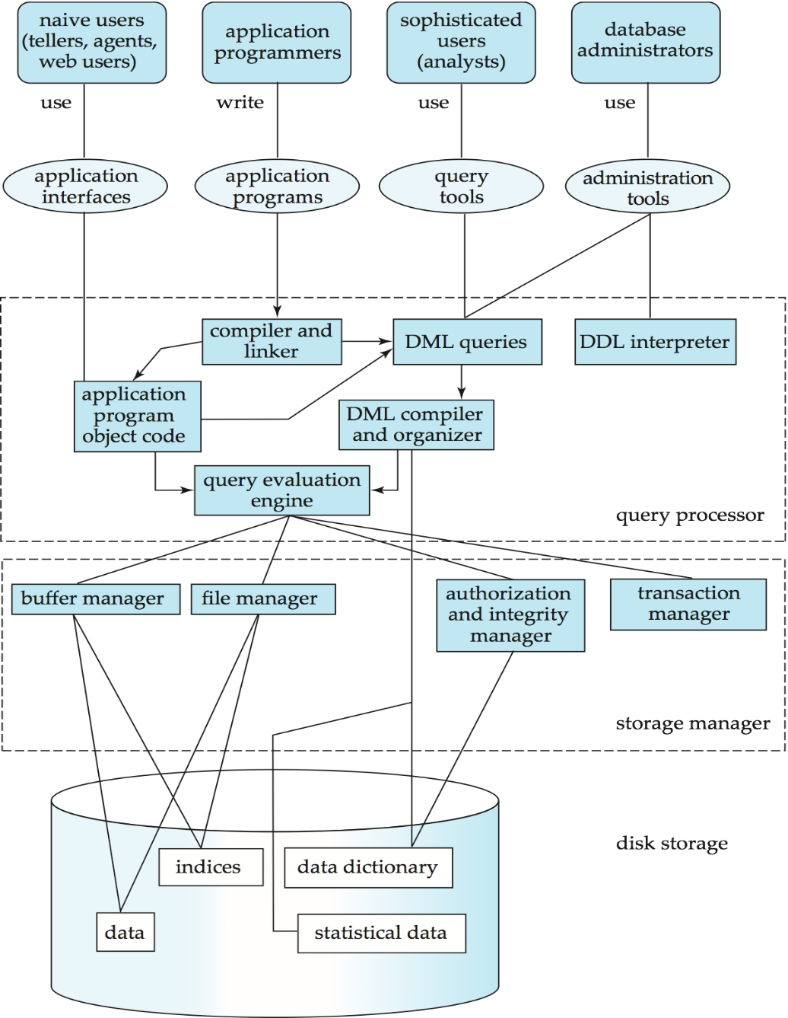
Database System Internals
Notes:
33

Slide 34
Database Users
Users are differentiated by the way they expect to interact with the system
Application programmers – interact with system through DML calls
Sophisticated users – form requests in a database query language
Specialized users – write specialized database applications that do not fit into the traditional data processing framework
Naïve users – invoke one of the permanent application programs that have been written previously
E.g. people accessing database over the web, bank tellers, clerical staff

Slide 35
Database Administrator
Coordinates all the activities of the database system; the database administrator has a good understanding of the enterprise’s information resources and needs.
Database administrator's duties include:
Schema definition
Storage structure and access method definition
Schema and physical organization modification
Granting user authority to access the database
Specifying integrity constraints
Acting as liaison with users
Monitoring performance and responding to changes in requirements

Slide 36
Database Architecture
The architecture of a database systems is greatly influenced by
the underlying computer system on which the database is running:
Centralized
Client-server
Parallel (multi-processor)
Distributed
Notes:
36

Slide 37
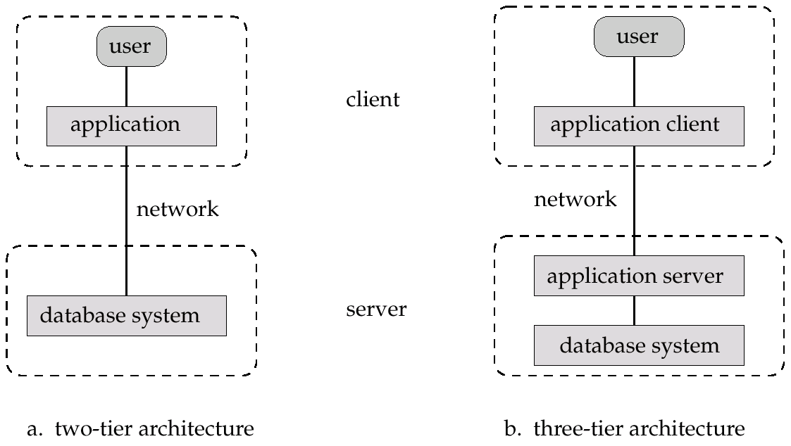
Application Architectures
Two-tier architecture: E.g. client programs using ODBC/JDBC to communicate with a database
Three-tier architecture: E.g. web-based applications, and applications built using “middleware”

Slide 38
Suggested Reading
Chapter 1 of Database System Concepts by Abraham Silberschatz
Chapter 1,2,3,4 of Database Systems: A Practical Approach to Design, Implementation, and Management by Thomas Conolly

